Slide 1



INFORMATION TECHNOLOGY PROJECT MANAGEMENT
Chap II: IT project Scope management
Lecturer: Dr. Thanh NGO

Slide 2

CONTENT
PROJECT SCOPE INTRODUCTION
PROJECT SCOPE MANAGEMENT PROCESSES
PROJECT SCOPE MANAGEMENT INITIATING & DEFINITION
WORK BREAKDOWN STRUCTURE (WBS)
CONTROL & MANAGE SOW CHANGE(S).

Slide 3

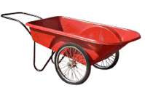




simple, red, robust, with wheels
Customer needs
Customer needs description
What the architect understands
What is the manufacturer expected to do
What the architect finally described
What is finally developed
CMC UNIVERSITY 2024

Slide 4
IMPORTANCE OF PROJECT SCOPE MANAGEMENT
  For a project manager, managing the expectations of the stakeholders and clients is one of the most challenging tasks. With a definite project scope, managers can easily stay on track and ensure that all the deadlines are being followed throughout the project life cycle.
  A well-defined project scope management helps avoid common issues like:
  Constantly changing requirements
  Pivoting the project direction when you are already mid-way
  Realizing that the final outcome isn’t what was expected
  Going over the discussed budget
  Falling behind the project deadlines
  Effective project scope management gives a clear idea about the time, labor, and cost involved in the project. It helps to distinguish between what is needed and what isn’t needed for accomplishing the project. Scope in project management also establishes the control factors of the project to address elements that might change during the project life cycle.
CMC UNIVERSITY 2024

Slide 5


1. PROJECT SCOPE INTRODUCTION
Project scope
“refers to the size of the project being completed. The size is measured in terms of project quality, complexity, quantity or magnitude of deliverable(s), detail, number of features and the capacity of the deliverable (such as the number of users a software can support)”
  Project scope is a definition of the end result or mission of the project – a product or service for the client/customer– in specific, tangible, and measurable terms.
  “The processes required to ensure that the project includes all the work required, and only the work required, to complete the project successfully”
  Answers the question – “What will the project produce in the end”.
Time
Scope
Cost
The Triple Constraint of Project Management
CMC UNIVERSITY 2024

Slide 6
PROJECT SCOPE INTRODUCTION
Why Do We Manage Scope?
Can’t manage schedule and budget if scope is out of control (Triple Constraint)
Scope docs are used to manage expectations
Scope
The triangle’s scope component refers to the size of the project being completed. The size is measured in terms of project quality, complexity, quantity or magnitude of deliverable(s), detail, number of features and the capacity of the deliverable (such as the number of users a software can support). Unmanaged and unintended scope creep—a negative increase in the project’s requirements—must be avoided to keep the project’s cost and time under control.
Some example choices that help to balance scope include:
  Adding or removing resources
  Employing a change management plan to keep scope in check
  Cutting nice-to-have tasks to make more room for priority ones
  Extending the project’s deadline
Time
Scope
Cost
CMC UNIVERSITY 2024

Slide 7
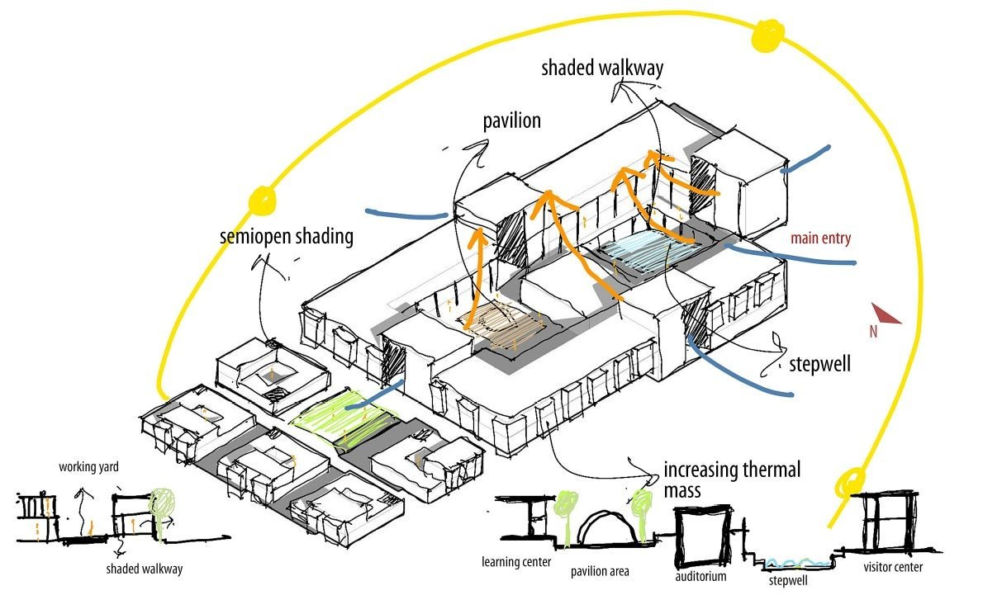
PROJECT SCOPE INTRODUCTION
Project
  “A temporary endeavor undertaken to create a unique product, service, or result “
      — PMBOK®
Conceptual Development
The process that addresses project objectives by finding the best ways to meet them
  Key steps in information development:
  Problem or need statement
  Requirements gathering
  Information gathering
  Constraints
  Alternative analysis
  Project objectives
  Business case
CMC UNIVERSITY 2024

Slide 8
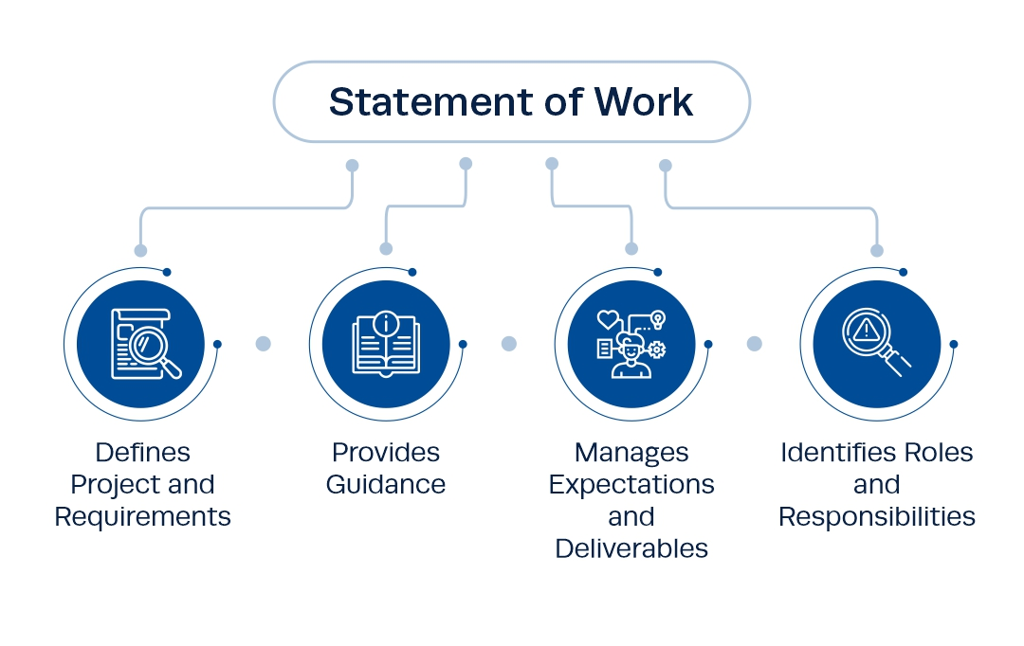
PROJECT SCOPE INTRODUCTION
Project
  “A temporary endeavor undertaken to create a unique product, service, or result “
      — PMBOK®
Statement of Work (SOW)
A SOW is a detailed narrative description of the work required for a project.
Effective SOWs contain:
  Introduction and background(project & requirements)
  Technical description of the project
  Roles & responsibilities
  Timeline and milestones
CMC UNIVERSITY 2024

Slide 9
PROJECT SCOPE INTRODUCTION
Project
  “A temporary endeavor undertaken to create a unique product, service, or result “
      — PMBOK®
Statement of Work Components
  Background
  Objectives
  Scope
  Task or Requirements
  Selection Criteria
  Deliverables or Delivery Schedule
  Security
  Period of Performance
CMC UNIVERSITY 2024

Slide 10
PROJECT SCOPE INTRODUCTION
Project
  “A temporary endeavor undertaken to create a unique product, service, or result “
      — PMBOK®
Project Charter
A document authorizing the project manager to initiate and lead the project.
A document issued by the project initiator or sponsor formally sanctioning existence of project and authorizes project manager to begin applying organizational resources to project activities. Project charter is created once project sponsors have verified that there is:
  a business case for the project
  elements of project are understood
  company-specific information for the project has been applied
Demonstrates formal company approval of the project
CMC UNIVERSITY 2024

Slide 11
PROJECT SCOPE INTRODUCTION
Project scope statement
The project scope statement documents the entire scope, including project and product scope
  Project scope encompasses product scope plus the work required to create the product: any project-related activities, such as documentation delivery and training
  Product scope encompasses the functional and non-functional requirements for the ﬁnal project deliverable
The project scope statement provides a common understanding of the project scope among project stakeholders
The project scope statement may contain explicit scope exclusions that can help to manage stakeholder expectations
  This can prevent the project from straying from the original vision in all project methodologies: sequential, iterative/incremental, and adaptive/agile
The project scope statement contents include:
  Product scope description. Progressively elaborates the characteristics of the product described in the project charter and requirements
  Product acceptance criteria. Conditions required for acceptance of deliverables
  Project deliverables. Deliverables include both product outputs and project outputs, such as project reports and documentation
  Project exclusions. Identiﬁes what is excluded from project
  Project constraints. Lists and describes anything that limits the project team's options, such as budget, imposed schedule, milestones, etc.
  Project assumptions. Lists and describes anything assumed to be true with respect to the scope and impact if these prove to be false
CMC UNIVERSITY 2024

Slide 12
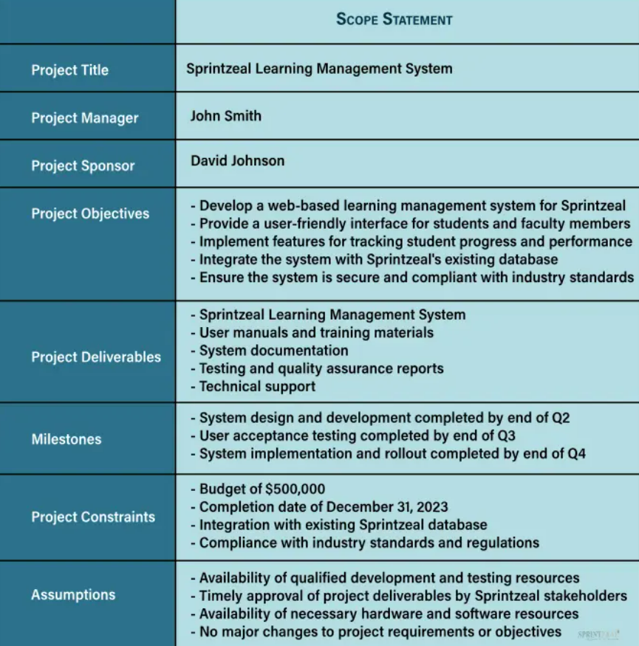
PROJECT SCOPE INTRODUCTION
Scope statement
Establish project goal criteria to include:
  Cost
  Schedule
  Performance
  Deliverables
  Review and approval “gates”
Develop management plan for project
Establish a Work Breakdown Structure
Create a scope baseline
CMC UNIVERSITY 2024

Slide 13
2. PROJECT SCOPE MANAGEMENT PROCESSES
“project scope management defines and controls what is and is not part of the project work”
Process Group | Management Process | Major Output
Planning | P1: Plan Scope Management | Scope Management Plan Requirement Management Plan
 | P2: Collect Requirements | Req. Documentation Req. Traceability Matrix
 | P3: Define Scope | Project Scope Statement Project Docs Update
 | P4: Create WBS | Scope Baseline Project Docs Update
Monitoring & Controlling | MC1: Validate Scope | Accept Deliverables Change Requests Work Performance Info
 | MC2: Control Scope | Change Requests Project Management Plan Updates Org, Process Asset Updates
CMC UNIVERSITY 2024

Slide 14
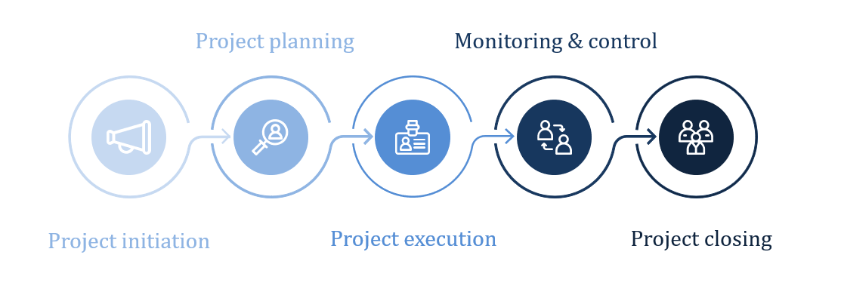
3. PROJECT SCOPE MANAGEMENT INITIATING & DEFINITION
INITIATION PHASE
  Project sponsor is identified
  Scope and deliverables are defined
  Relationship to organizational goals is key
  Budget is approved
  Broad statements are made about risks, approach, timelines
  Stakeholders are identified
  Project Manager is assigned
  At end of phase, approved project charter is the approval to proceed to the planning phase
CMC UNIVERSITY 2024

Slide 15
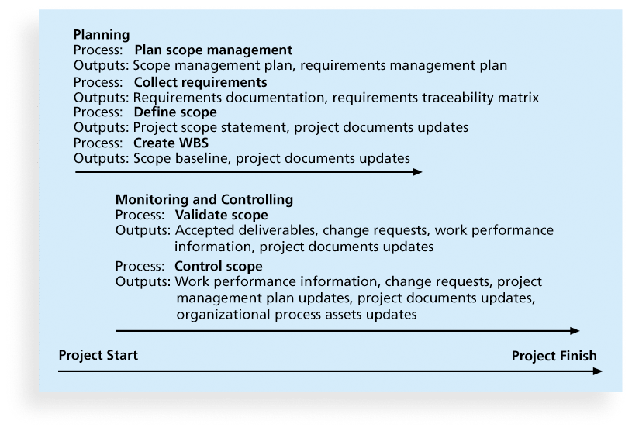
PROJECT SCOPE MANAGEMENT INITIATING & DEFINITION
Project
  “A temporary endeavor undertaken to create a unique product, service, or result “
      — PMBOK®
  Planning scope
  Collecting requirements
  Defining scope
  Creating the WBS
  Validating scope
  Controlling scope
CMC UNIVERSITY 2024

Slide 16
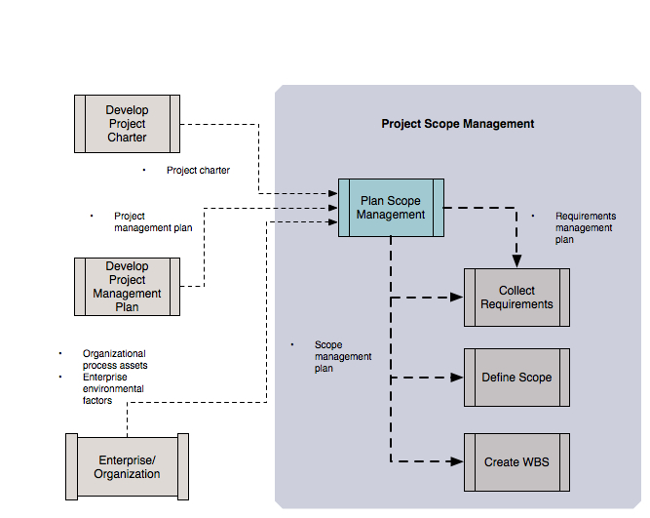
PROJECT SCOPE MANAGEMENT INITIATING & DEFINITION
Plan Scope Management: Data Flow Diagram
CMC UNIVERSITY 2024

Slide 17
PROJECT SCOPE MANAGEMENT INITIATING & DEFINITION
Scope management plan
According to PMBOK 5: “The scope management plan can be formal or informal, broadly framed or highly detailed, based on the needs of the project.”
The components of a scope management plan include:
  Process for preparing a detailed project scope statement
  Process that enables the creation of the WBS from the detailed project scope statement
  Process that establishes how the WBS will be maintained and approved
  Process that speciﬁes how formal acceptance of the completed project deliverables will be obtained
  Process to control how requests for changes to the detailed project scope statement will be processed—this process is directly linked to the Perform Integrated Change Control process
CMC UNIVERSITY 2024

Slide 18
PROJECT SCOPE MANAGEMENT INITIATING & DEFINITION
Requirements management plan
Components of the requirements management plan can include, but are not limited to:
  How requirements activities will be planned, tracked, and reported
  Conﬁguration management activities such as:
  How changes to the product will be initiated
  How impacts will be analyzed, how they will be traced, tracked, and reported
  Authorization levels required to approve these changes
  Requirements prioritization process
  Product metrics that will be used and the rationale for using them
  Traceability structure to reﬂect which requirement attributes will be captured on the traceability matrix
CMC UNIVERSITY 2024

Slide 19
PROJECT SCOPE MANAGEMENT INITIATING & DEFINITION
Collect Requirements
Collecting initial requirements is a critical ﬁrst step in managing requirements over the course of the project
  In an iterative/incremental or adaptive/agile project, requirements collection continues throughout the life cycle of the project
  Types of requirements
  Business requirements. Describe the high-level needs of the organization as a whole
  Examples: Increase e-commerce purchases by 25%
  Stakeholder requirements. Describe the needs of a particular stakeholder, especially with respect to external stakeholders
  Example: As the owner, I want to develop an e-commerce application
  Functional requirements. Describe the behavior of the product
  Example: As a retail customer, I want to be able to shop by brand or product category on the e-commerce application
  Nonfunctional requirements. Describe the behavioral qualities required for the product to be effective
  Example: As the e-commerce application owner, I want the e-commerce application to be available 99.99% of the time over a 1-year period
  Quality requirements. Capture condition or criteria needed to validate the successful completion of a project deliverable
  Example: As the e-commerce application owner, I want a retail customer test group to be able to successfully search for and ﬁnd a requested product within 30 seconds
CMC UNIVERSITY 2024

Slide 20
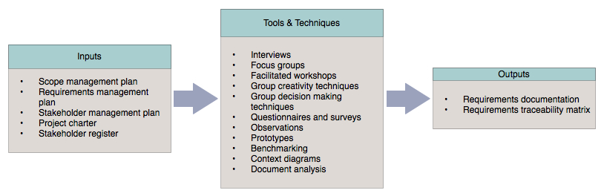
PROJECT SCOPE MANAGEMENT INITIATING & DEFINITION
Inputs, tools & techniques, and outputs
CMC UNIVERSITY 2024

Slide 21

4. WORK BREAKDOWN STRUCTURE (WBS)
Work Breakdown Structure (WBS)
“a deliverable-oriented hierarchical decomposition of the work to be executed by the project team to accomplish the project objectives and create the required deliverables. It organizes and defines the total scope of the project. Each descending level represents an increasingly detailed definition of the project work. The WBS is decomposed into work packages. The deliverable orientation of the hierarchy includes both internal and external deliverables.”.
A work breakdown structure (WBS) is a fundamental project management tool that represents a hierarchical decomposition of projects. It helps to break down complex activities into more manageable parts with the aim to manage, evaluate, and assign them to anyone in a team.
  What is to be done
  When it is to be start and finished
  Who is going to do this
  Defining the right activities is essential for “project scope management”
CMC UNIVERSITY 2024

Slide 22
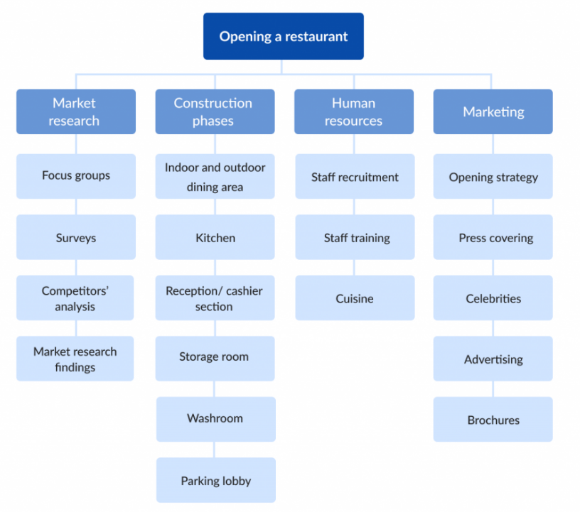
WORK BREAKDOWN STRUCTURE (WBS)
Some commonly used terms used with WBS project management include:
Acceptance Criteria: Standards to be met to achieve customer or other stakeholder requirements
Budget: Expenses associated with the project, which can be broken down by deliverables or phases
Deliverables: The product, service or results created at various stages of the project. For instance, in a website design project, a deliverable-based WBS would be structured around deliverables such as URL, layout and written content
Milestones: Critical stages of the project identified in the WBS
Phases: The various stages of a project. For instance, in a website design project, a phase-based WBS would be structured around things like discovery, design and launch, rather than specific deliverables
A Work Package is: “…the work defined at the lowest level of the work breakdown structure for which cost and duration are estimated and managed.”
CMC UNIVERSITY 2024

Slide 23
WORK BREAKDOWN STRUCTURE (WBS)
Breaks large project into manageable units
  Total project
  Subprojects
  Milestones (completion of an important set of work packages)
  Major activities (summary tasks)
  Work packages (tasks, activities, work elements)
Helps to
  Identify all work needing to be done
  Logically organize work so that is can be scheduled
  Assign work to team members
  Identify resources needed
  Communicate what has to be done
  Organize work using milestones
CMC UNIVERSITY 2024

Slide 24
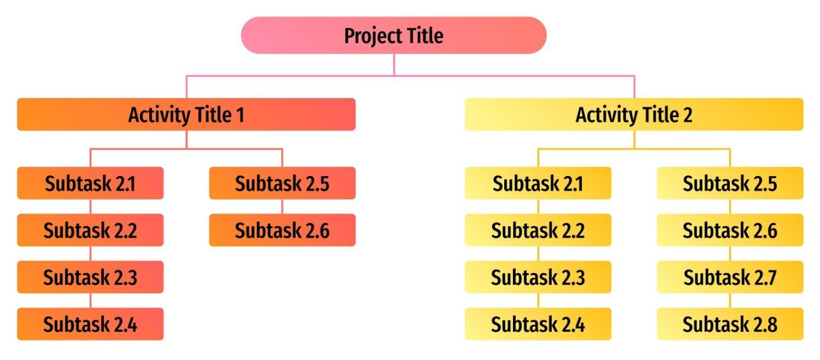
WORK BREAKDOWN STRUCTURE (WBS)
WBS benefits
Why create a work breakdown structure?
A work breakdown structure (WBS) is a tool that can be used for projects, programs, and even initiatives to understand the work that has to be done to successfully produce a deliverable(s). The purpose of creating a WBS:
  To define:
  Solution strategy or general approach
  Implementation tactics
  To support more accurate estimates of project duration and cost than can be made at the project level
  To provide a basis for estimating project resources:
  Departmental or subcontractor support
  Vendors and their products
  Services
  Any other identifiable resource
CMC UNIVERSITY 2024

Slide 25
WORK BREAKDOWN STRUCTURE (WBS)
Uses for the WBS
Thought process tool
  The WBS is a design and planning tool.
  It helps the project manager and the project team visualize exactly how the work of the project can be defined and managed effectively.
Architectural design tool
  The WBS is a picture of the work of the project and how the items of work are related to one another.
Planning tool
  In the planning phase, the WBS gives the project team a detailed representation of the project as a collection of activities that must be completed in order for the project to be completed.
  It is at the lowest activity level of WBS that we will estimate effort, elapsed time, and resource requirements; build a schedule of when the work will be completed; and estimate deliverable dates and project completion.
Project status reporting tool.
  The WBS is used as structure for reporting project status.
  The project activities are consolidated from the bottom as lower-level activities are completed.
  Completion of lower-level activities cause higher-level activities to be partially complete.
  Therefore, WBS defines milestone events that can be reported to senior management and to the customer.
CMC UNIVERSITY 2024

Slide 26
WORK BREAKDOWN STRUCTURE (WBS)
Six Criteria to Test for Completeness in the WBS
The WBS is developed as part of a Joint Planning session. But how do you know that you've done this right? Each activity must possess six characteristics to be considered complete – that is, completely decomposed. The six characteristics are
  Status/completion is measurable
  Start/end events are clearly defined
  Activity has a deliverable
  Time/cost is easily estimated
  Activity duration is within acceptable limits
  Work assignments are independent
Measurable Status: The project manager can ask for the status of an activity at any point in time during the project. If the activity has been defined properly, that question is answered easily.
  Example: a system's documentation is estimated to be about 300 pages long and requires approximately four months of full-time work to write, here is a possible report that a developer can provide regarding the status: “I’ve written 150 pages, so I guess I am 50 percent complete.”
Bounded: Each activity should have a clearly defined start and end event. Once the start event has occurred, work can begin on the activity. The deliverable is most likely the end event that signals work is closed on the activity.
CMC UNIVERSITY 2024

Slide 27
WORK BREAKDOWN STRUCTURE (WBS)
Six Criteria to Test for Completeness in the WBS
The WBS is developed as part of a Joint Planning session. But how do you know that you've done this right? Each activity must possess six characteristics to be considered complete – that is, completely decomposed. The six characteristics are
  Status/completion is measurable
  Start/end events are clearly defined
  Activity has a deliverable
  Time/cost is easily estimated
  Activity duration is within acceptable limits
  Work assignments are independent
Deliverable
  The result of completing the work that makes up the activity is the production of a deliverable.
  The deliverable is a visible sign that the activity is complete.
  This could be an approving manager's signature, a physical product or document.
Cost/Time Estimate
  Each activity should have an estimated time and cost of completion.
  Being able to do this at the lowest level of decomposition in the WBS allows you to aggregate to higher levels and the total project cost and the completion date.
CMC UNIVERSITY 2024

Slide 28
WORK BREAKDOWN STRUCTURE (WBS)
Six Criteria to Test for Completeness in the WBS
The WBS is developed as part of a Joint Planning session. But how do you know that you've done this right? Each activity must possess six characteristics to be considered complete – that is, completely decomposed. The six characteristics are
  Status/completion is measurable
  Start/end events are clearly defined
  Activity has a deliverable
  Time/cost is easily estimated
  Activity duration is within acceptable limits
  Work assignments are independent
Activity Independence
  It is important that each activity be independent. Once work has begun on the activity, it can continue reasonably without interruption and without the need of additional input or information until the activity is complete.
  Though it is possible that an activity could be scheduled during different times based on resource availability.
CMC UNIVERSITY 2024

Slide 29
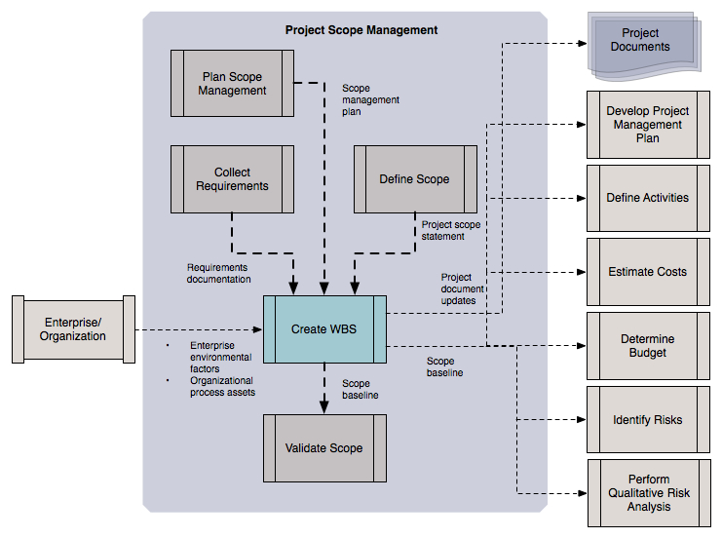
WORK BREAKDOWN STRUCTURE (WBS)
CMC UNIVERSITY 2024

Slide 30
WORK BREAKDOWN STRUCTURE (WBS)
Decomposition activities
  Identify and analyze the deliverables and related work
  The project scope statement provides the basis for the first iteration of deliverable identification
  Structure and organize the WBS according to an appropriate high-level hierarchy
  For IT projects using an iterative system development model, a phase/iteration/discipline hierarchy most closely matches the SDLC process
  Note that one of the disciplines in the iterative SDLC process is ‘Project Management’– it is here that appropriate project management processes may be entered
  Decompose the upper WBS levels into lower-level detailed components
  If appropriate, larger deliverables may be decomposed into smaller deliverables, all the way down to the work package level
  Develop and assign identification codes to the WBS components
  Note that each item in the WBS has both a unique identifier (the code or account identifier) and a WBS code
  The unique identifier does not change if a component is moved about in the WBS structure; however, the WBS code does change
  Verify that the amount of decomposition of work is necessary and sufficient
  This can be translated into a simple concept: the ‘just right’ principle
  The just right principle states that no more decomposition is needed–it would be too detailed–and any less decomposition would be too coarse
  Insufficient decomposition leads to reduced ability to plan, manage, and control the work
  Excessive decomposition leads to wasted effort and decreased efficiency
CMC UNIVERSITY 2024

Slide 31
WORK BREAKDOWN STRUCTURE (WBS)
Validate the WBS
  All major elements been identified at top level?
  Decomposed into measurable components?
  Lower level(s) items necessary? All inclusive?
  Would stakeholders agree WBS is satisfactory?
  Can elements be scheduled, budgeted, and assigned to a unit that will accept responsibility?
  Too much or too little visibility and control ?
  Can status reports be generated at all levels?
CMC UNIVERSITY 2024

Slide 32
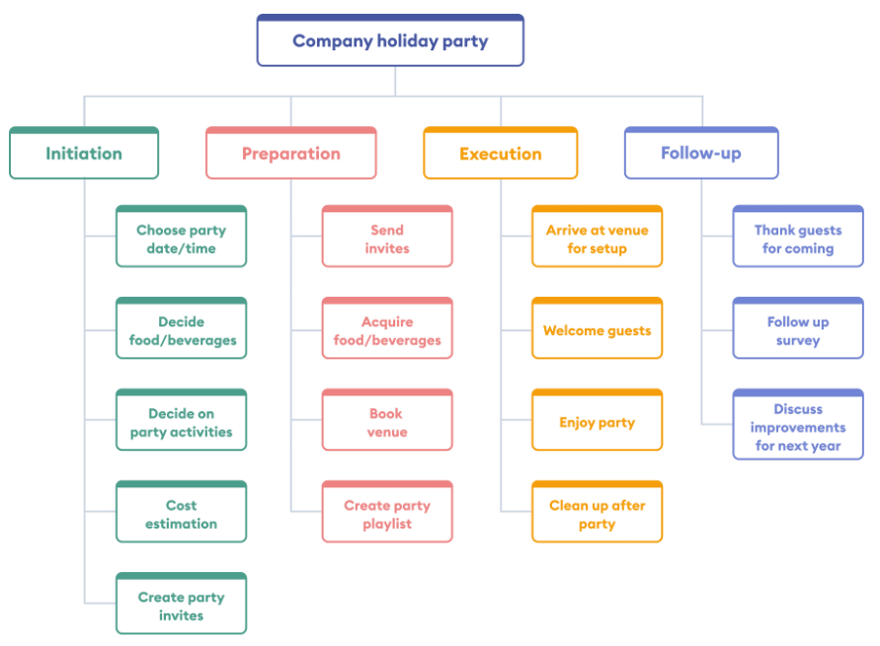
WORK BREAKDOWN STRUCTURE (WBS)
Project
  “A temporary endeavor undertaken to create a unique product, service, or result “
      — PMBOK®
WBS Example
CMC UNIVERSITY 2024

Slide 33
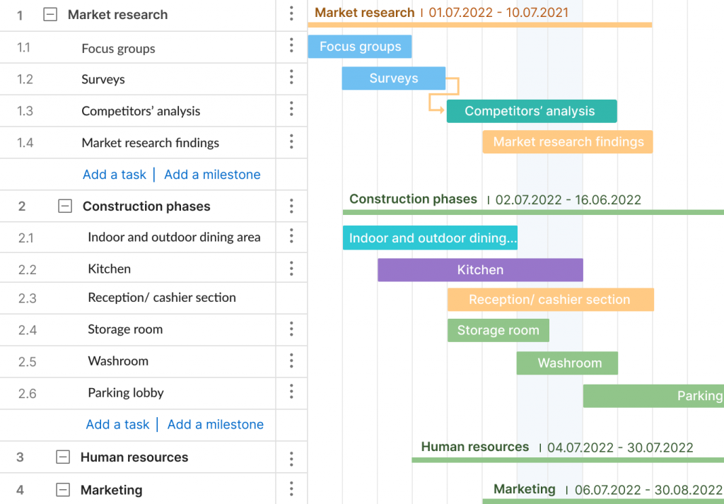
WORK BREAKDOWN STRUCTURE (WBS)
Project
  “A temporary endeavor undertaken to create a unique product, service, or result “
      — PMBOK®
WBS Example (Gantt)
CMC UNIVERSITY 2024

Slide 34
5. CONTROL & MANAGE SOW CHANGE(S)
Project scope Change Management
  Project scope Change Management
Any change to product and/or project scope must follow a formal process. This process must finish with the formal acceptance of the change by the different stakeholders.
A change request may be the result of :
  An external event (eg. Change in a government regulation)
  An error or omission in defining the scope of the product (adding a failure system regulation).
  An error in defining the scope of the project (a missing inspection)
  A value adding change (positive opportunity)
  A response to an identified risk
Change(s) in scope
mid-project
Poor estimates in the planning phase
41 %
39%
CMC UNIVERSITY 2024

Slide 35
THANK YOU!
Chap II: IT project Scope management
Lecturer: Dr. Thanh NGO

